Slide 1

Band-gap Prediction
Franz Rivera Tellez

Slide 2
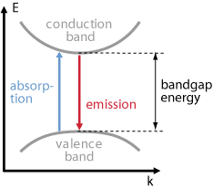
Band-gap
Band-gap, also known as energy band gap, refers to the energy difference between the valence band (the highest energy level of electrons in a material that are still bound to an atom) and the conduction band (the lowest energy level of electrons that are free to move around in a material and conduct electricity).

Slide 3

why is it important?
The size of the band-gap determines whether a material is an insulator, semiconductor or conductor
Insulators
have a large band-gap and do not conduct electricity well,
conductors
have a small band-gap and conduct electricity easily.
Semiconductors
have a band-gap in between insulators and conductors

Slide 4
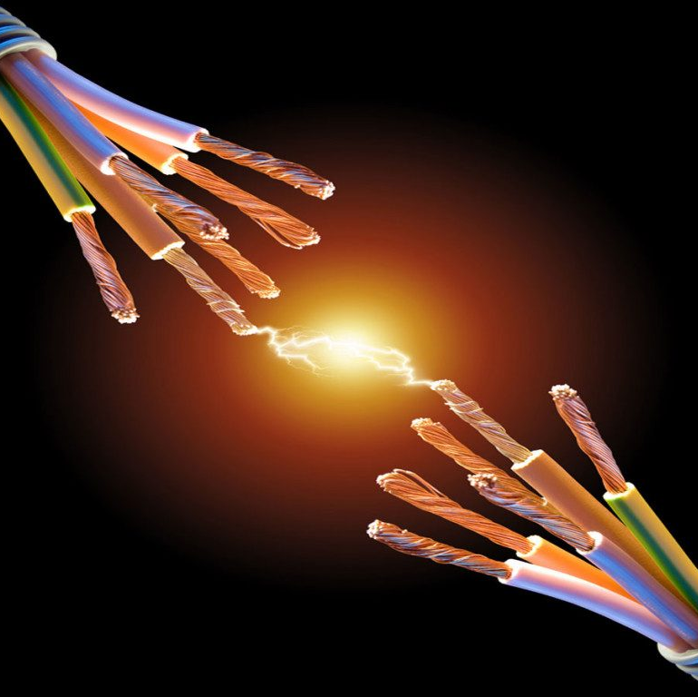
Applications of Band-gap knowledge
Conductivity can be controlled by varying their band-gap through the addition of impurities or by changing their temperature.
Plays a crucial role in the development of electronic devices such as transistors, solar cells, and light-emitting diodes (LEDs).

Slide 5

Dataset

Slide 6
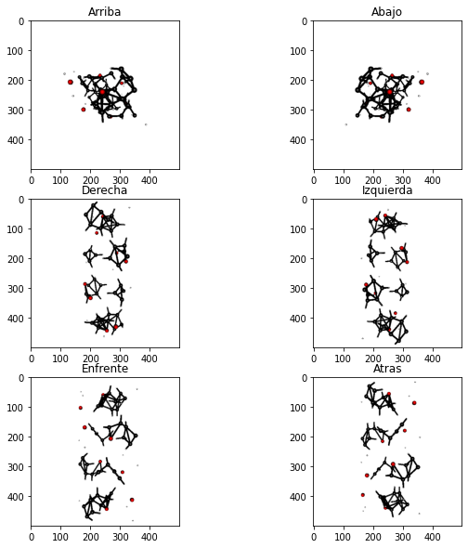
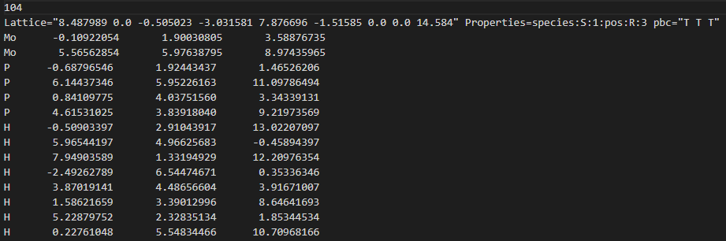
OMDB-GAP1
+ radii * scale

Slide 7

possible models

Slide 8
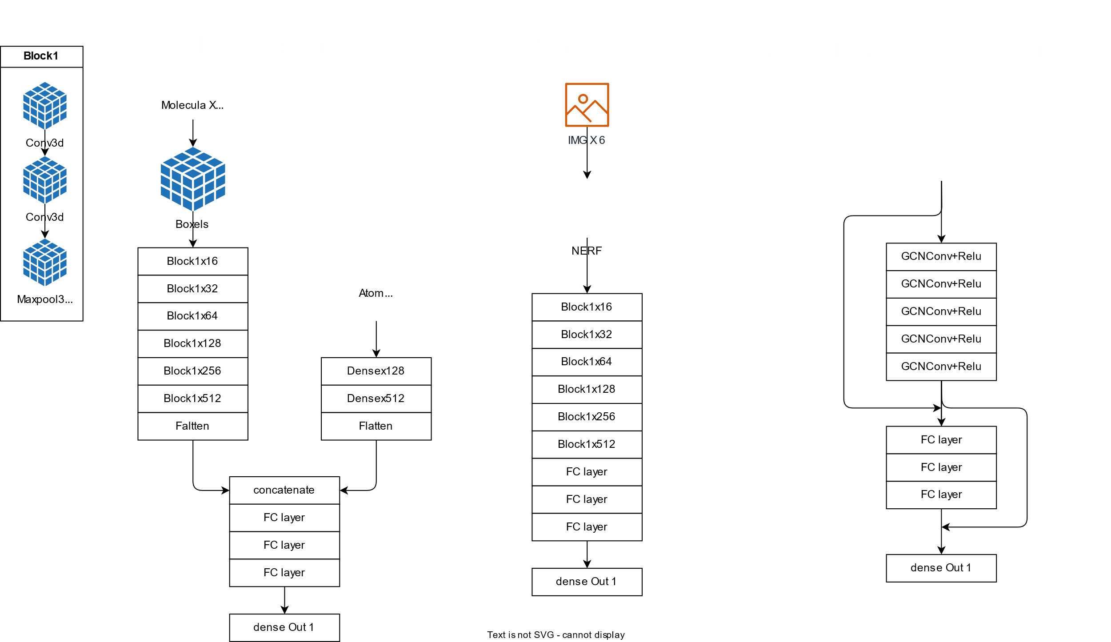

3D Boxels approach

Slide 9
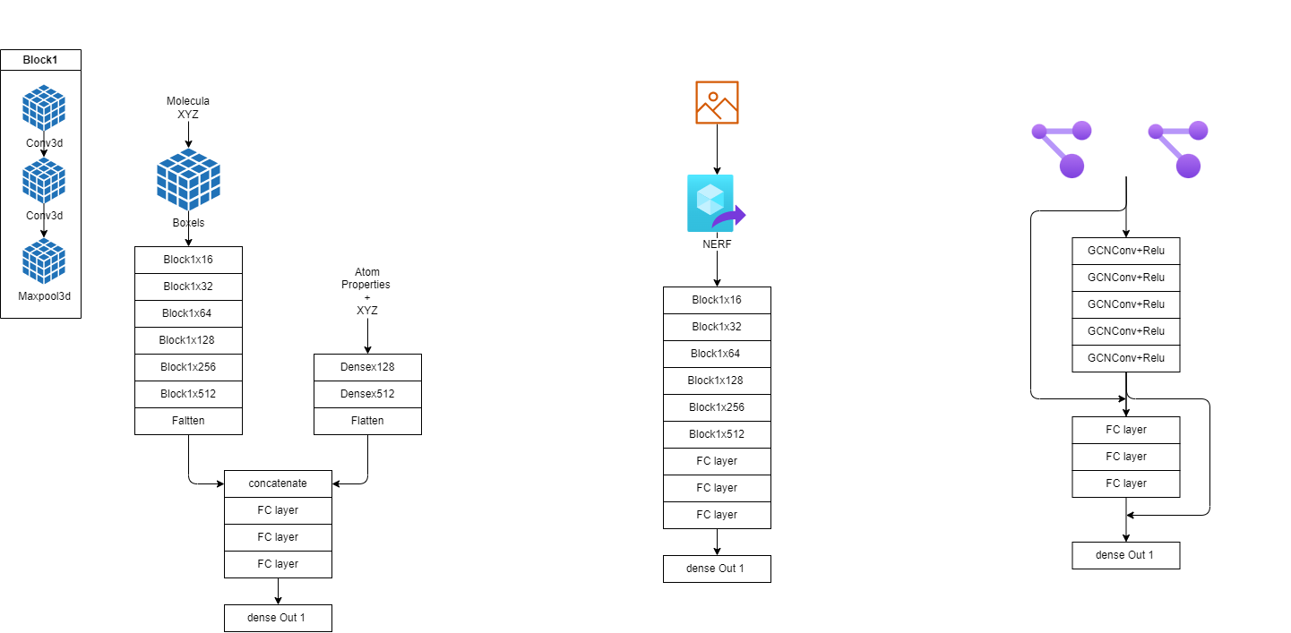
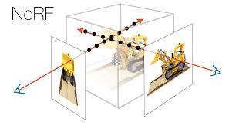
2D img to 3D

Slide 10
Graph Neural Network approach

Slide 11
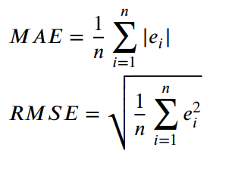
metrics

